Slide 1
Introduction to Brain Anatomy
27 June 2016

Slide 2
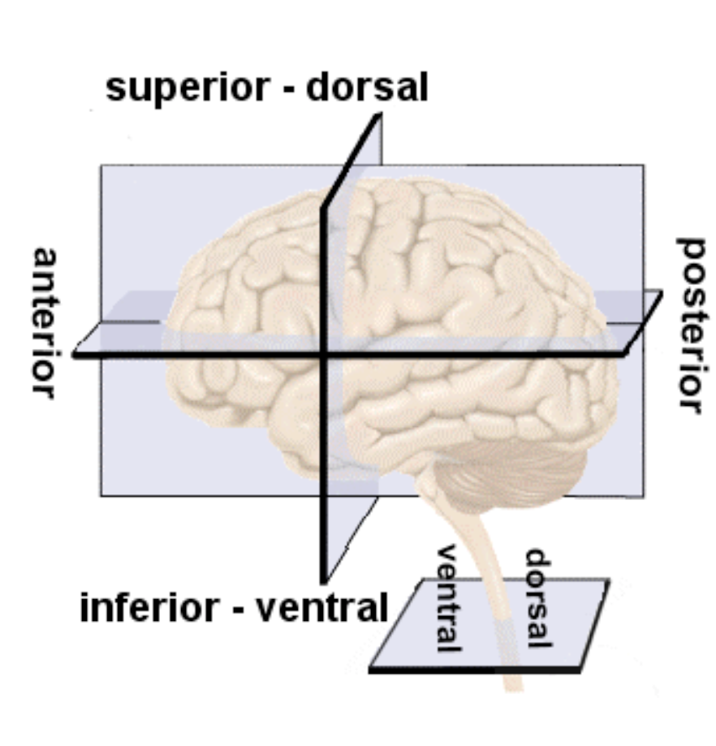

Slide 3
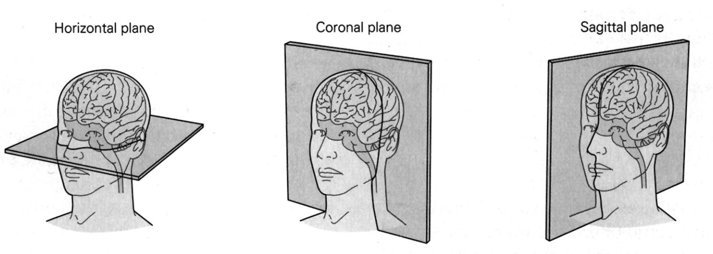

Slide 4
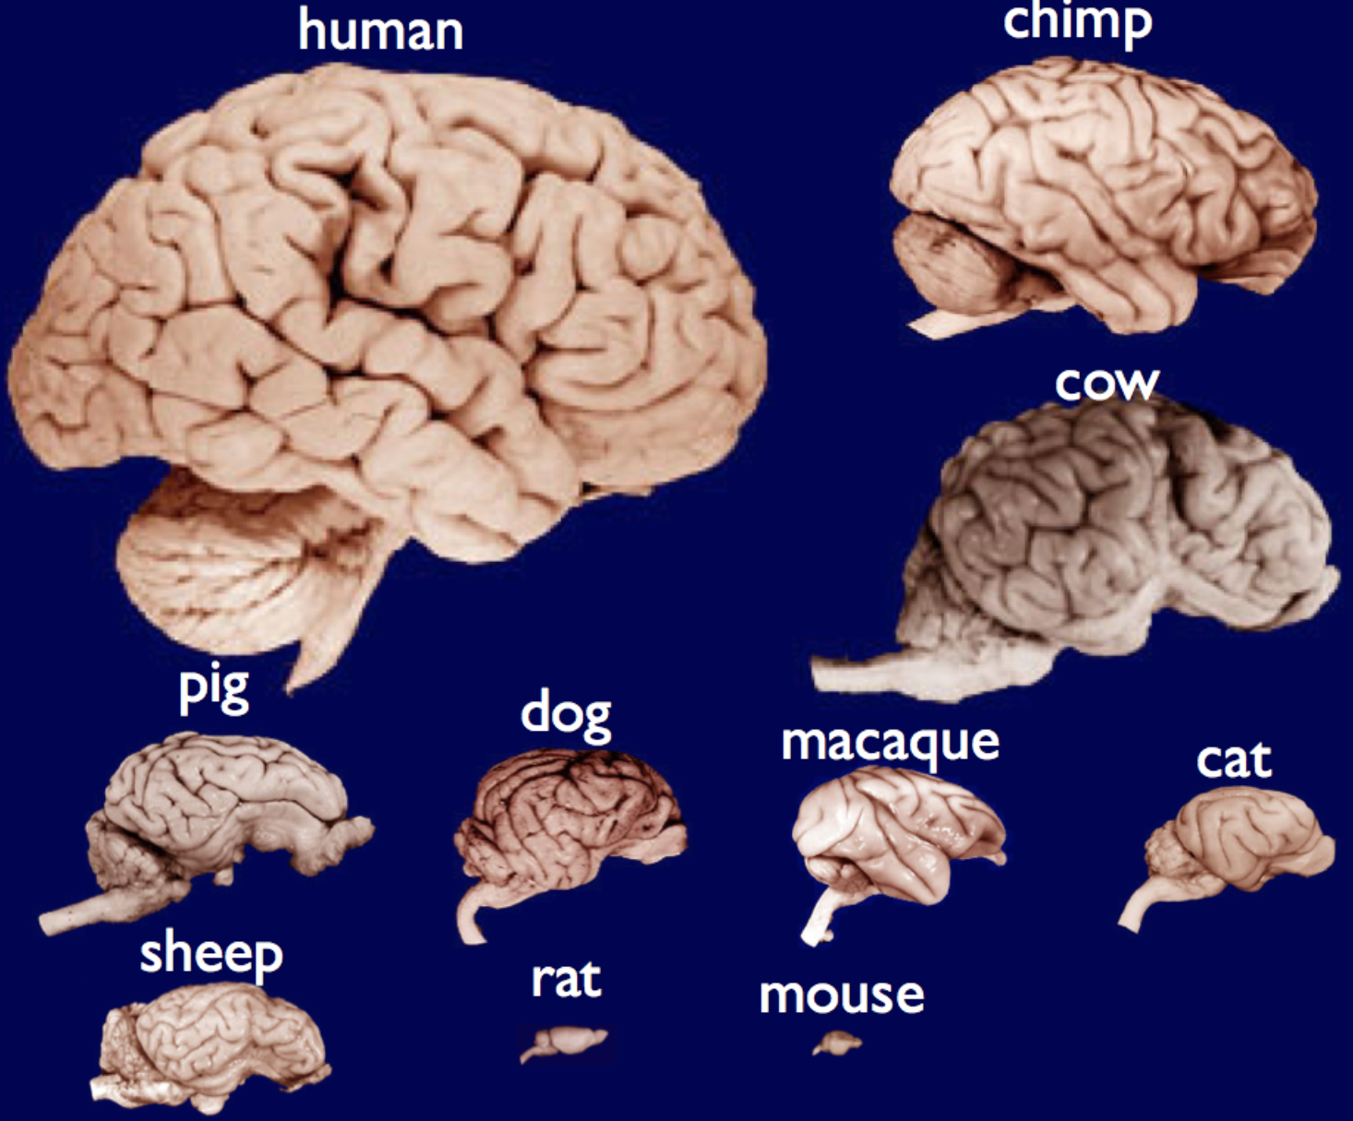

Slide 5
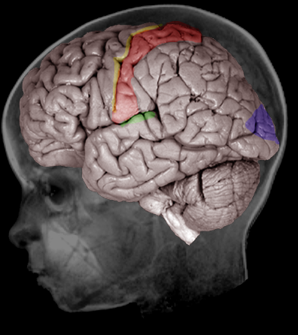
What does the rest of the brain do?
Motor
Touch
Vision
Hearing

Slide 6
Some rules of thumb
How/where
What/who

Slide 7
Some rules of thumb
Planning
Controling/
Inhibiting

Slide 8
Some rules of thumb
Combining and comparing information

Slide 9
The brain mostly makes sense
Motor
Touch
Vision
Hearing
Halfway between visual cortex and autiory cortex. Probably is involved in combining AV signals

Slide 10
The brain mostly makes sense
Motor
Touch
Between proprioceptive cortex and visual cortex and is dorsal. Probably involved in spatial orientation
Vision
Hearing

Slide 11
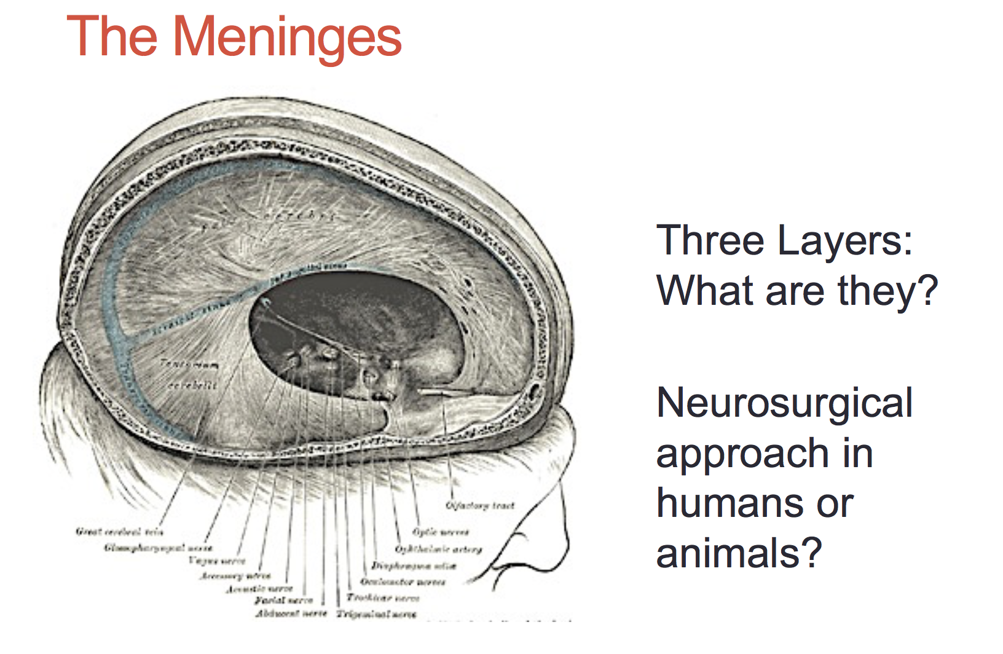

Slide 12
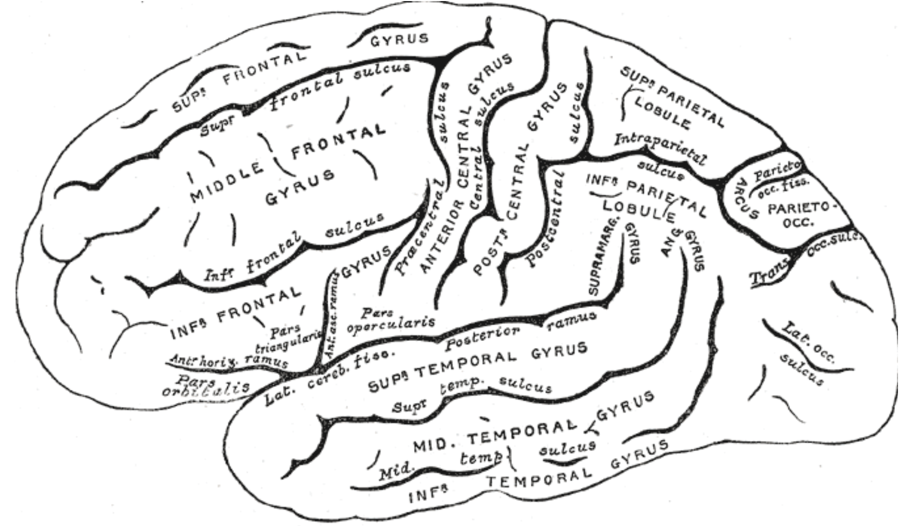

Slide 13
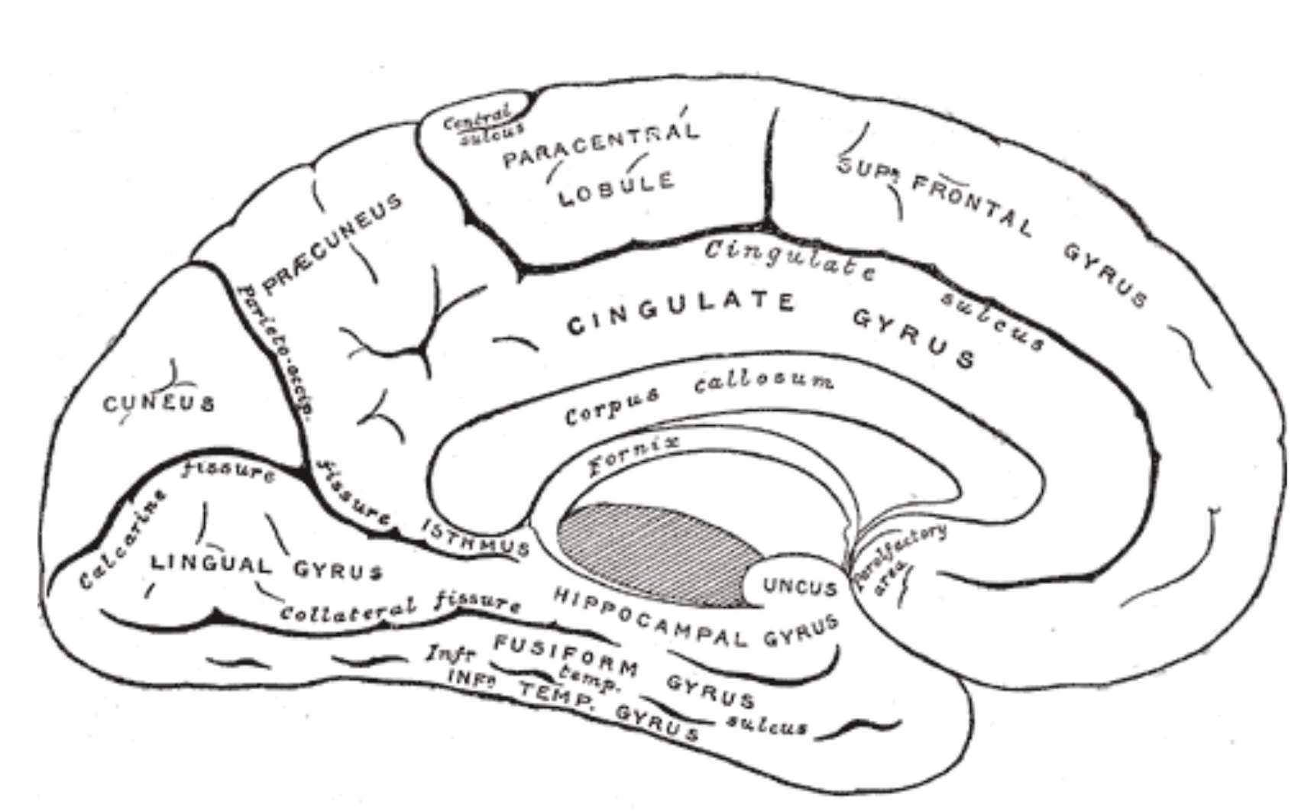

Slide 14
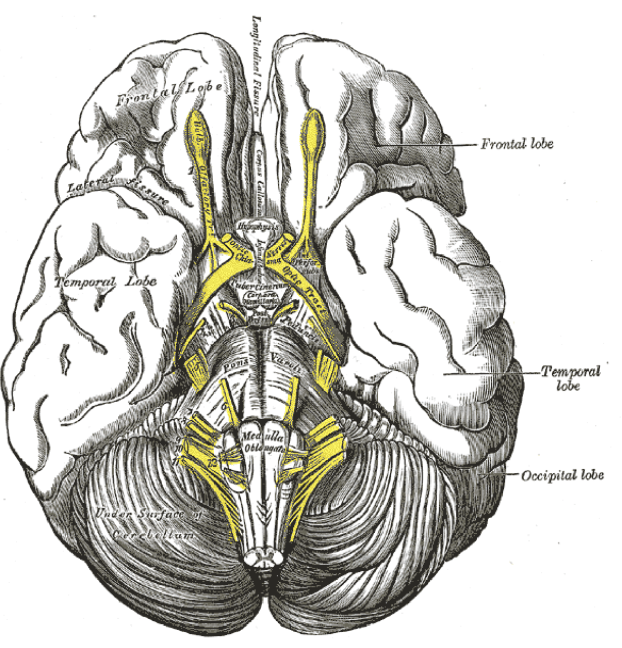

Slide 15
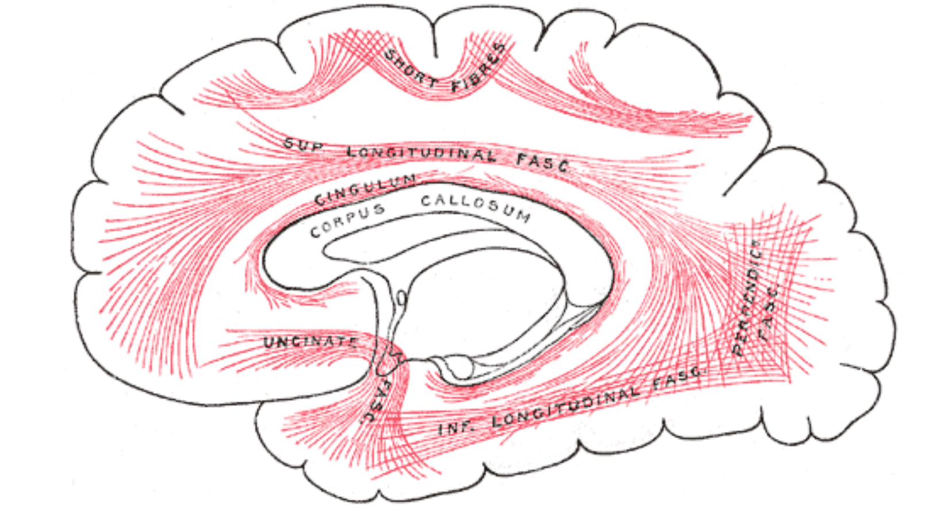

Slide 16
Is there any real meaningful way of dividing the brain into regions?
Optional?

Slide 17
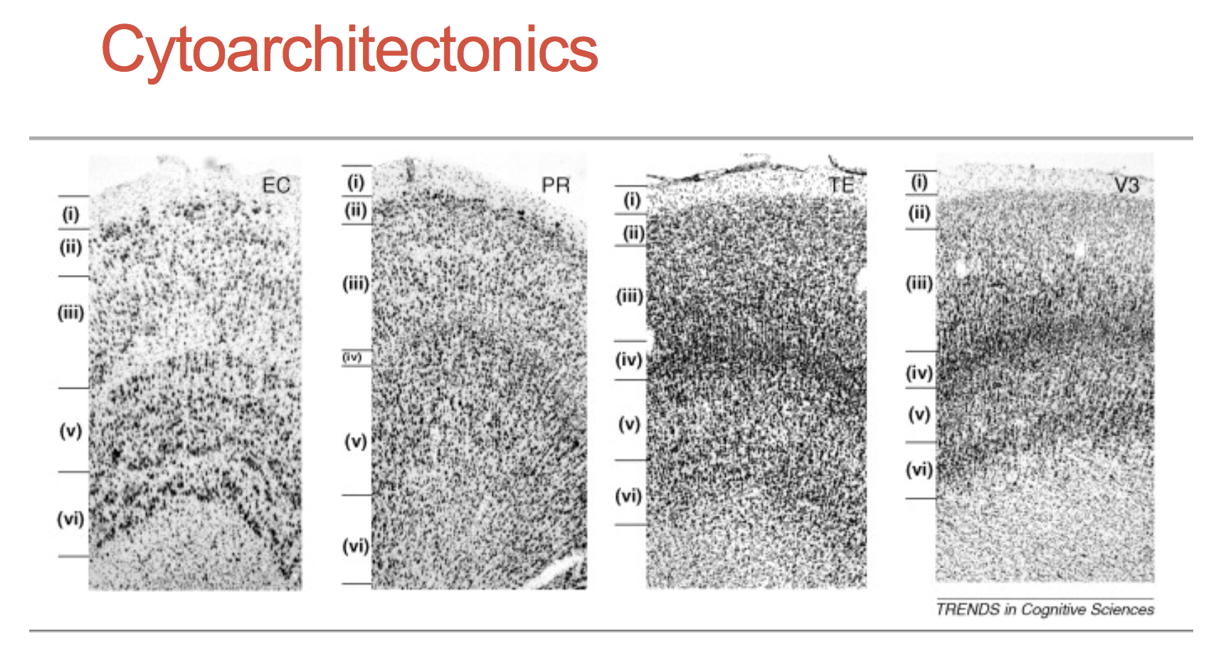

Slide 18
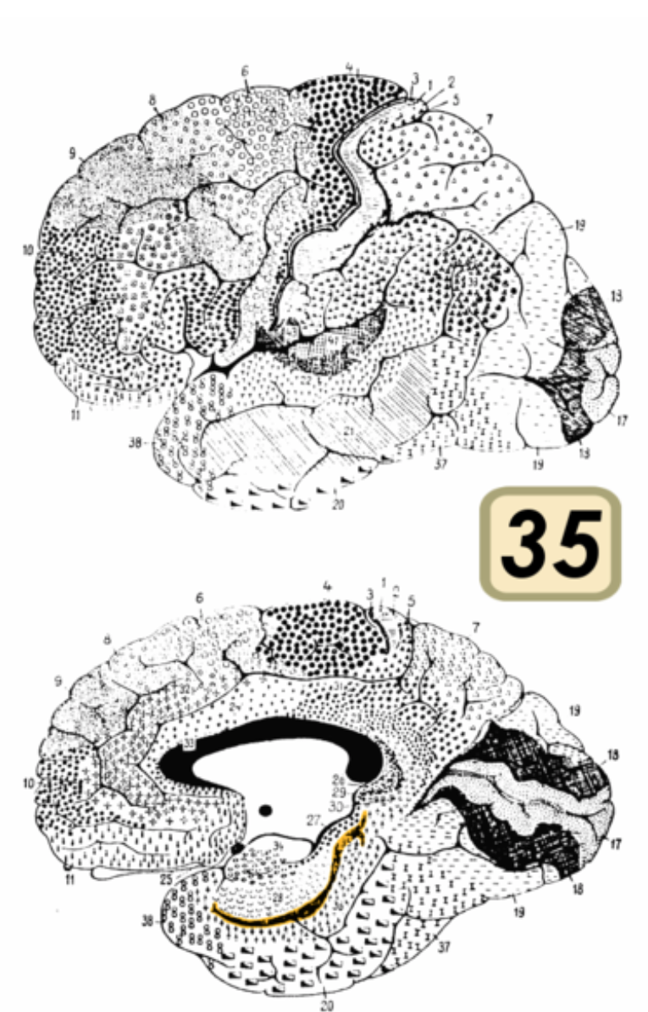

Slide 19
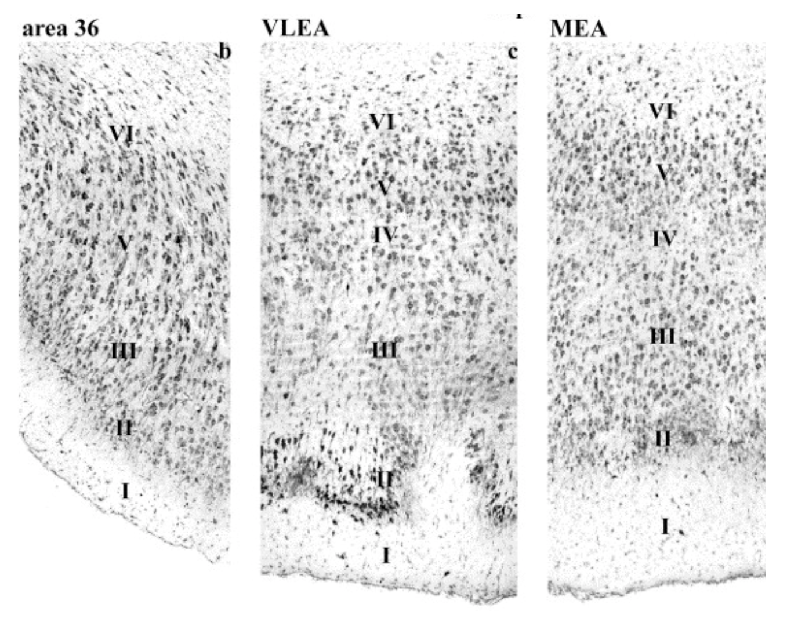

Slide 20
